Slide 1
1 2 Sim?
Easy CGE Modeling
David Roland-Holst
Manoj Potaphon
Sam Heft-Neal
Training for Thailand Climate Risk Assessmet Capacity
Office of Agricultural Economics, MOAC, Bangkok, Thailand
FAO project TCPTHA3303
27 November, 2012

Slide 2
1-2-3 CGE Model
1 country, 2 activities, 3 commodities
2 activities, producing D and E.
  E not consumed domestically.
Additional commodity, M, consumed domestically but not produced.

Slide 3
Sturctural Assumptions
Aggregate GDP (X) is fixed.
  Full employment model.
Trade balance set exogenously.
World prices of M and E are fixed.
Total absorption (Q) is endogenous.

Slide 4
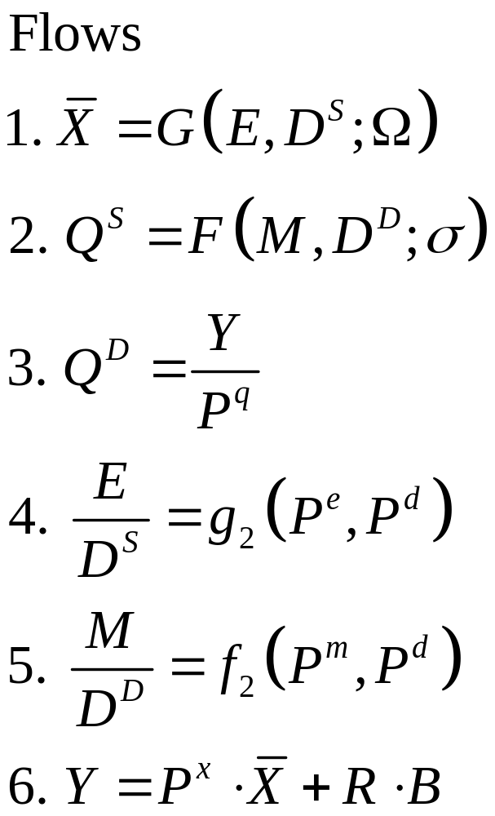
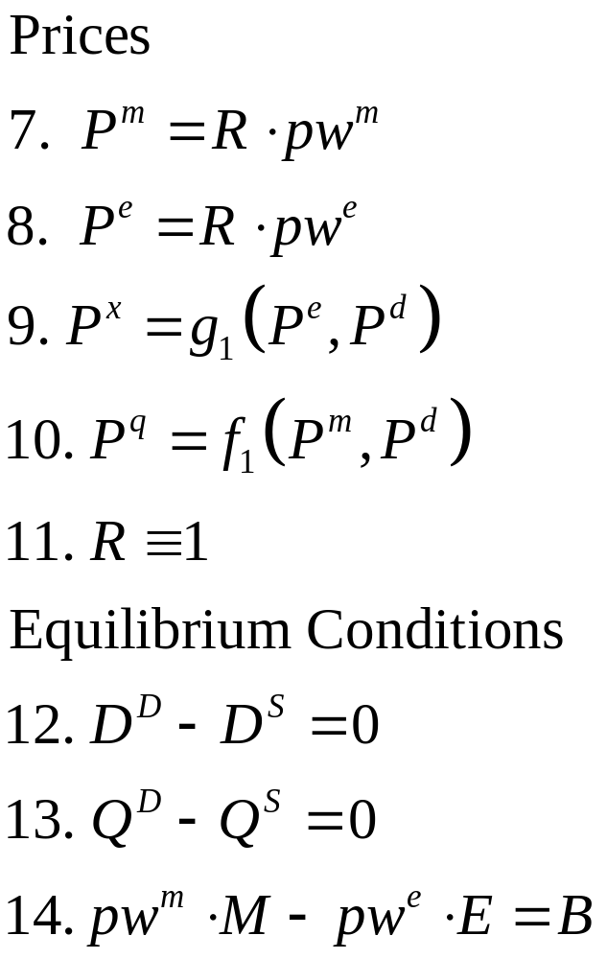
Analytical 1-2-3 Model

Slide 5
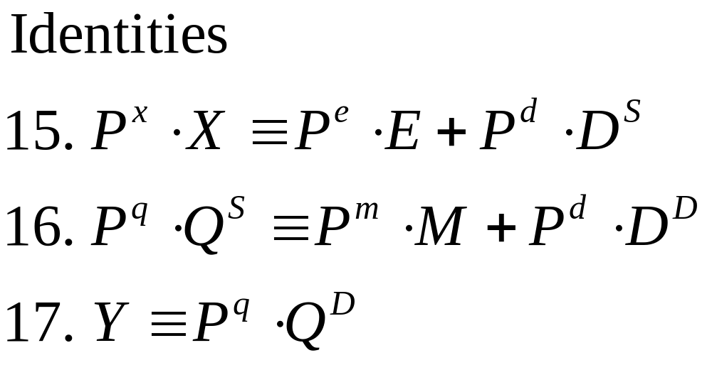
1-2-3 CGE Model

Slide 6
Definitions for the 1-2-3 CGE Model
Endogenous Variables
E: Export good
M: Import good
D^{S}: Supply of domestic good
D^{D}: Demand for domestic good
Q^{S}: Supply of composite good
Q^{D}: Demand for composite good
Y: Total income
P^{e}: Domestic price of export good
P^{m}: Domestic price of import good
P^{d}: Domestic price of domestic good
P^{x}: Price of aggregate output
P^{q}: Price of composite good
R: Exchange rate
Exogenous Variables
pw^{e}: world price of export good
pw^{m}: world price of import good
B: Balance of trade
σ: Import substitution elasticity
Ω: Export transformation elasticity

Slide 7
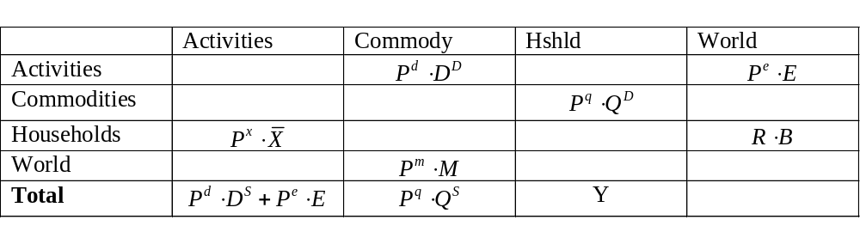
SAM 1-2-3

Slide 8
Trade Schematically
CES
CET
Impor t s
Exports
slope=-PD/PE
slope=-PD/PM
slope = E/D = k (P_{E} / P_{D} ) ^{σ}
slope = M/D = k (P_{D} / P_{M} ) ^{σ}
Indifference
Curve
PPF
Domestic Goods/Services
Domestic Goods/Services

Slide 9
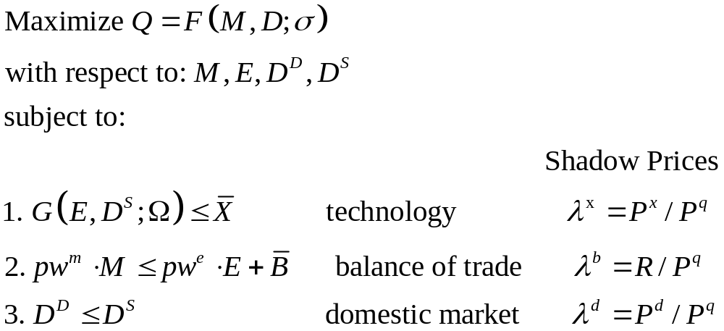
1-2-3 as a Programming Model

Slide 10
Assumptions
A CET transformation technology between a domestic good D and an export Good E
CES preferences in final demand over D and imports M
A fixed balance of trade
Fixed government demand and investment (example of “macroeconomic closure”)
Fixed terms-of-trade (small country assumption)
Macro identities hold (income constraints, balance of trade, etc.

Slide 11
1-2-3 Model Descriptively
M
P_{M}M=P_{E}E + B
P_{D}/P_{M}
D^{D}
E
P_{D}/P_{E}
D^{D} = D^{S}
D^{S}

Slide 12
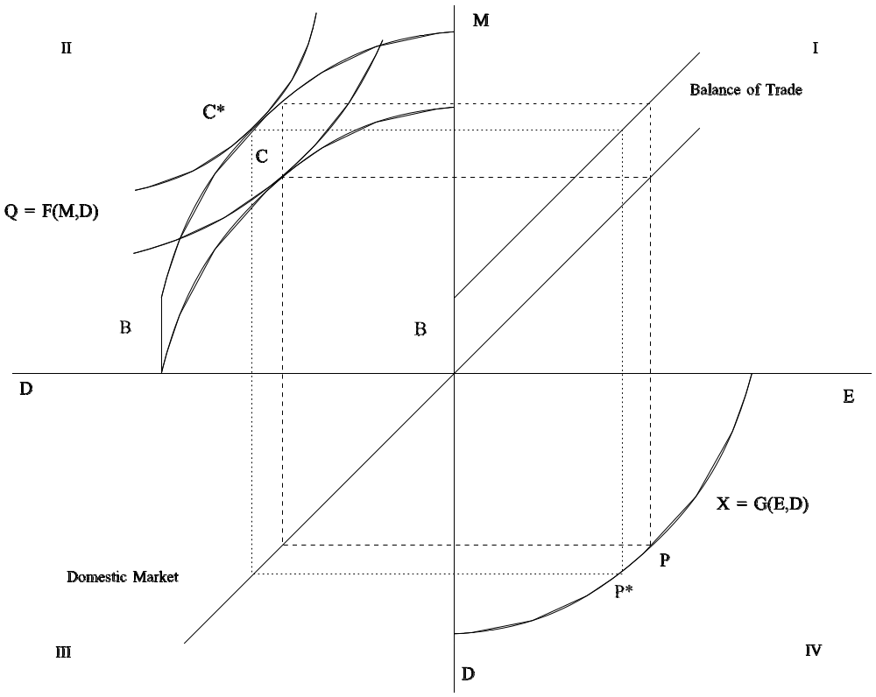
Foreign Capital Inflow
B↑

Slide 13
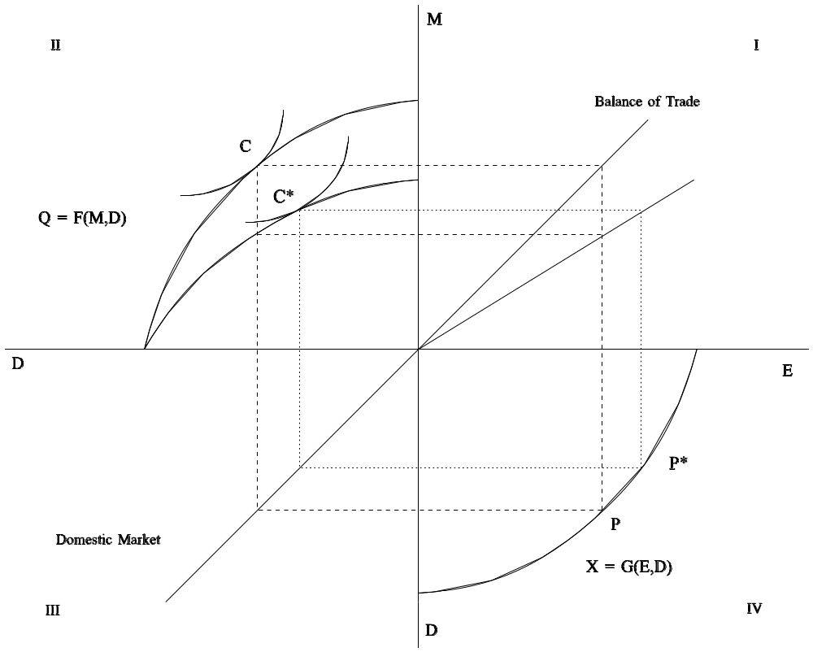
Terms of Trade Deterioration
P_{E}/P_{M}↓

Slide 14
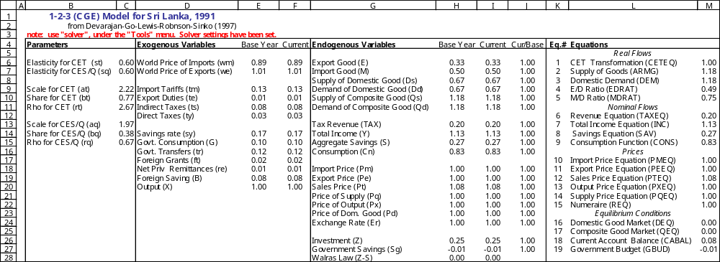
The 123 model in Excel
19 endogenous variables and equations
variables are “scaled” as a share of GDP
Basic inputs are macroeconomic accounts data

Slide 15
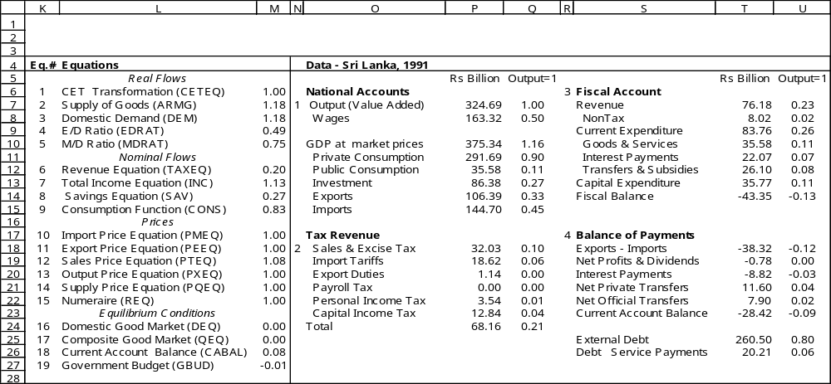
The 123 model in Excel
19 endogenous variables and equations
variables are “scaled” as a share of GDP
Basic inputs are macroeconomic accounts data

Slide 16
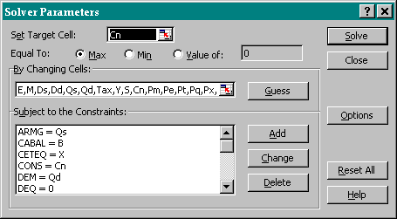
Variables are identified to the solver by name

Slide 17
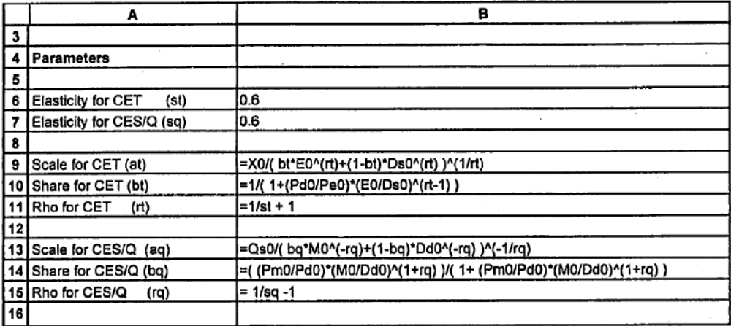
Calibration
Must run the solver any time parameters or baseline data are changed.
EAE 5918

Slide 18
Simulation
To run a counterfactual experiment
  Change the Current values of Exogenous Variables (column F of the 1-2-3 Model Sheet)
  Run the Solver
  Examine Results Summary and Endogenous Variables
  NB: Be sure to re-calibrate after each experiment

Slide 19
Moving to GAMS
The Excel version of 1-2-3 is easily accessible, but must be highly simplified to be tractable.
Using a higher level programming language enables us to include more economic structure and behavior.
The Generalized Algebraic Modeling System (GAMS) is the language of choice for this kind of work.

Slide 20
A Model with Consumption, Government, and Investment
Real Flows Prices
(1) X = G(E,D^{S};omega) (10) Pm = (1 + tm)⋅R ⋅ pwm
(2) Q^{S} = F(M,D^{D};sigma) (11) Pe = (1 + te) ⋅ R ⋅ pwe
(3) Q^{D} = C + Z +G (12) Pt = (1 + ts) ⋅ Pq
(4) E/D^{S} = g2(Pe,Pd) (13) Px = g1(Pe,Pd)
(5) M/D^{D} = f2(Pm,Pt) (14) Pq = f1(Pm,Pt)
(15) R = 1
Nominal Flows Equilibrium Conditions
(6) T = tm ⋅ R ⋅ pwm ⋅ M
+ ts ⋅ Pq ⋅ Q^{D} (16) D^{D} ‑ D^{S} = 0
+ ty ⋅ Y ‑ te ⋅ R ⋅ pwe ⋅ E (17) Q^{D} ‑ Q^{S} = 0
(7) Y = Px ⋅ X + tr ⋅ Pq + re ⋅ R (18) pwm ⋅ M ‑ pwe ⋅ E ‑ ft ‑ re = B
(8) S = s ⋅ Y + R ⋅ B+ Sg (19) Pt ⋅ Z ‑ S = 0
(9) C ⋅ Pt = (1 ‑s ‑ ty) ⋅ Y (20) T ‑ Pq ⋅ G ‑ tr ⋅ Pq ‑ ft ⋅ R ‑ Sg = 0
Accounting Identities
(i) Px ⋅ X = Pe ⋅ E + Pd ⋅ D^{S}
(ii) Pq ⋅ Q^{S}= Pm ⋅ M + Pt ⋅ D^{D}

Slide 21
Definitions
Endogenous Variables Exogenous Variables
  E: Export good pwm: World price of import good
  M: Import good pwe: World price of export good
  DS: Supply of domestic good tm: Tariff rate
  DD: Demand for domestic good te: Export subsidy rate
  QS: Supply of composite good ts: sales/excise/value‑added tax rate
  QD: Demand for composite good ty: direct tax rate
  Pe: Domestic price of export good tr: government transfers
  Pm: Domestic price of import good ft: foreign transfers to government
  Pd: Producer price of domestic good re: foreign remittances to private sector
  Pt: Sales price of composite good s : Average savings rate
  Px: Price of aggregate output X: Aggregate output
  Pq: Price of composite good G: Real government demand
  R: Exchange rate B : Balance of trade
  T: Tax revenue rhot: Export transformation elasticity
  Sg: Government savings rhoc: Import substitution elasticity
  Y: Total income
  C: Aggregate consumption
  S: Aggregate savings
  Z: Aggregate real investment
EAE 5918

Slide 22
123 SAM
Act
Com
Hshld
Gov
Cap
Wrld
Act
D
E
Com
C
G
Z
Hshld
Y
Govt
T_{X}
T_{H}
Cap
S_{H}
S_{G}
S_{F}
Wrld
M
EAE 5918

Slide 23
Diagrammatic 1-2-3 model
Slope=P_{D}/P_{M}
M
Balance of Trade
Q = F(M,D)
P_{M}M=P_{E}E + B
Slope =P_{E}/P_{M}
D^{D}
E
Slope =P_{D}/P_{E}
D^{D} = D^{S}
X = G(E,D)
Domestic Market
D^{S}

Slide 24
Foriegn Capital Inflow
M
C*
B
C
Q=F(M,D)
B
Slope = pd/pm
E
D
X=G(E,D)
Slope =pd/pe
Domestic Market
P
D
Real Appreciation
EAE 5918

Slide 25
Adverse Terms of Trade Movement
Q=F(M,D)
M
C
P_{E}/P_{M} ↓
C*
Slope = pd/pm
E
D
X=G(E,D)
Slope =pd/pe
D
Real Depreciation
Domestic Market
EAE 5918

Slide 26
Accessing GAMS
The homepage of the GAMS corporation (www.gams.com) contains a lot of useful information.
From the homepage, a full user guide can be downloaded at www.gams.com/docs/document.htm; the user guide contains the syntax for all GAMS commands and very helpful as a reference when writing GAMS models. Note that the user guide is also available via the Help function in GAMS-IDE.
All readers are advised to study the introductory chapter of this manual when starting to learn the GAMS software.

Slide 27
Questions?

